Slide 1

NCAA Basketball Tournament Predicting 2017 Winning Scores
IST 707
Professor Lin
By: Prasad Kulkarni, Mike Jung

Slide 2
INTRODUCTION
Every year, the NCAA women’s basketball teams play thousands of matches that will lead up to the popular March Madness championship. The championship consists of 64 teams and builds up from early October until February, where the top 16 teams per each of the four regions compete for the championship, with the final game usually played in March or April.
For this project, we’ve taken data from the NCAA Women’s basketball tournaments, spanning from 1998 to 2017. These data include every game played for every season, whether the game was played at home or away, which team won, the final score, number of overtimes played, and if the game was part of the regular season or March Madness Tournament.
Our objective is to take these data points and try to build a model that is capable of correctly predicting the score of the winning team for the 2017 women’s basketball season.

Slide 3
DATA
The dataset was obtain from the 2018 Women’s NCAA March Madness Kaggle competition. https://www.kaggle.com/c/womens-machine-learning-competition-2018/data
Nine files were read into R. Relevant columns were combined into a single data frame and were used for our predictions.
'data.frame': 97945 obs. of 24 variables:
$ Season : num 1998 1998 1998 1998 1998 ...
$ gameId : chr "1998_3104_3202_1" "1998_3163_3221_1" ...
$ DayZero : Date, format: "1997-10-27" "1997-10-27" "1997-10-27" ...
$ gameDay : Date, format: "1997-11-14" "1997-11-14" "1997-11-14"...
$ DayNum : int 18 18 18 18 18 18 18 19 19 19 ...
$ WTeamID : int 3104 3163 3222 3307 3349 3435 3443 3119 3139 ...
$ WScore : int 91 87 66 69 115 65 89 75 71 74 ...
$ LTeamID : int 3202 3221 3261 3365 3411 3172 3257 3331 3103 ...
$ LScore : int 41 76 59 62 35 63 73 47 68 58 ...
$ WLoc : Factor w/ 3 levels "A","H","N": 2 2 2 2 2 2 2 2 1 2 ...
$ NumOT : int 0 0 0 0 0 0 0 0 0 0 ...
$ gameType : chr "regularSeason" "regularSeason" "regularSeason" ...
$ WTeamSeed : Factor w/ 64 levels "W01","W02","W03",..: NA ...
$ LTeamSeed : Factor w/ 64 levels "W01","W02","W03",..: NA NA...
$ WRegion : chr NA NA NA NA ...
$ LRegion : chr NA NA NA NA ...
$ lgPS : num 75.4 75.4 75.4 75.4 75.4 ...
$ lgPA : num 60.3 60.3 60.3 60.3 60.3 ...
$ WTeamOR : num 1.054 1.126 0.953 0.986 1.019 ...
$ WTeamDR : num 0.953 0.963 0.913 0.875 0.95 ...
$ WTeamPointSpread: num 21.9 26.7 16.7 21.5 19.5 ...
$ LTeamOR : num 1.095 1.114 1.008 1.065 0.802 ...
$ LTeamDR : num 1.133 1.027 0.984 0.978 1.079 ...
$ LTeamPointSpread: num -19.31 -10.12 -13.33 -9.43 -32.91 ...

Slide 4
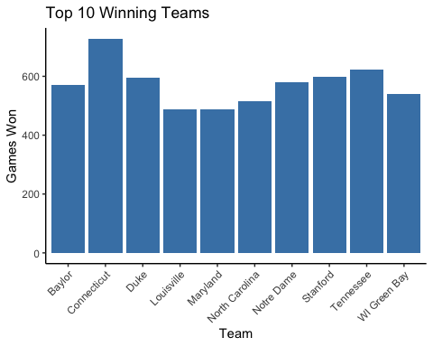
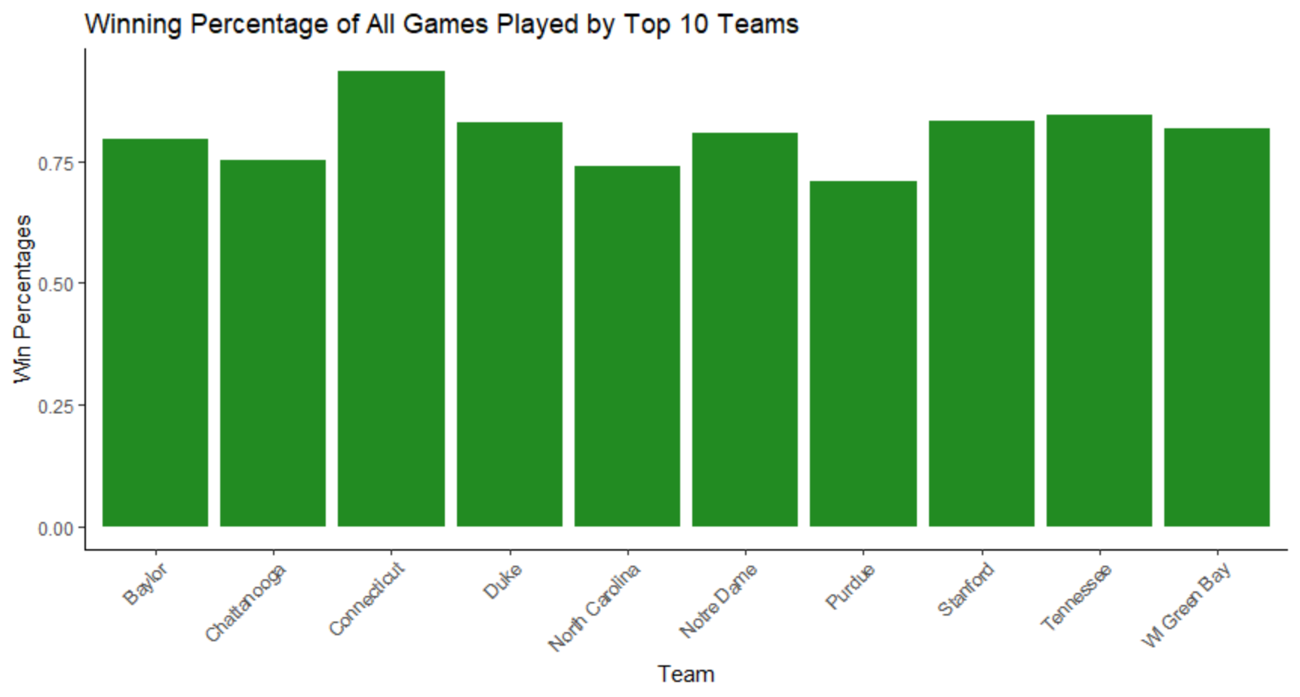
EXPLORATORY DATA ANALYSIS
To get an idea of the strong teams in the league, the top ten teams based on the total amount of matches won were plotted.
Top winning teams all have significantly higher win rate. The winning teams average a 75% winning percentage.

Slide 5
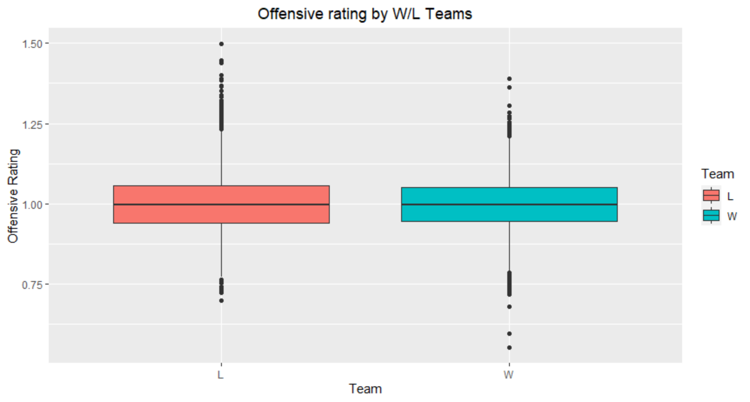
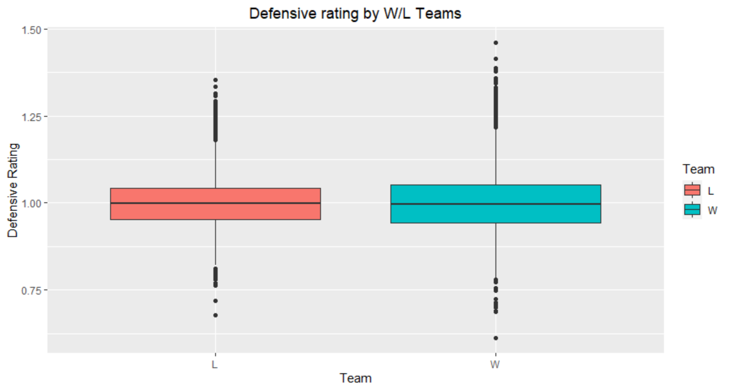
EXPLORATORY DATA ANALYSIS
Offensive and Defensive Ratings
On average, losing teams tend to have higher offensive ratings. Perhaps the reason for this is because they are highly aggressive offensively, leaving their defense open and allowing opposing teams to score. In the end, the old mantra might prove to be true: defense wins championships.
Analysis of the boxplot for defensive ratings shows a larger spread of defensive ratings for winning teams, supporting the hypothesis drawn from the Offensive Rating boxplot.

Slide 6
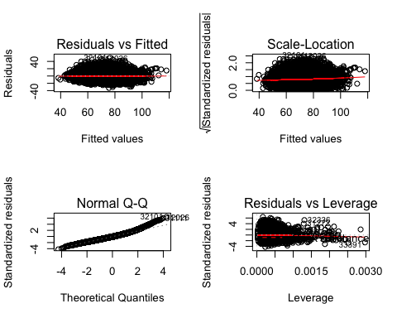
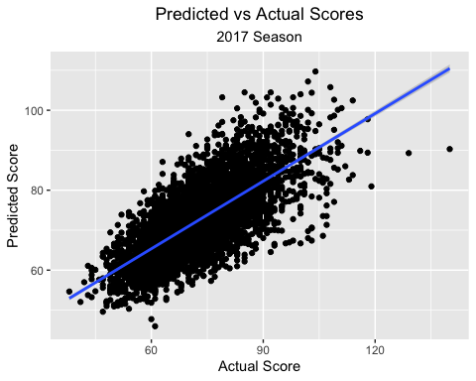
PREDICTION
Linear Regression Model
The regression summary (right) confirms all variables are significant in determining the winning score of the match.
Adjusted R-square is fairly low for the model at 0.5339.
The root mean squared error indicates that the WScore is overall off by 7.9 points in either direction which is not bad (below).

Slide 7
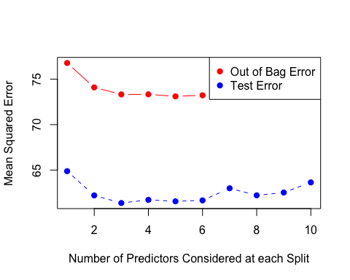
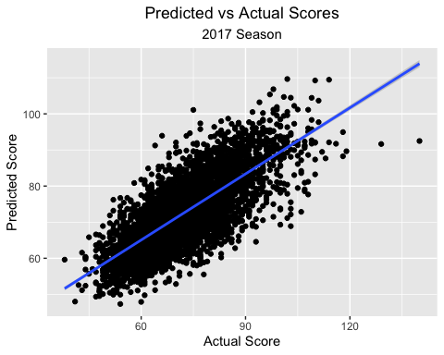
PREDICTION
Random Forest
The number of variables is ideally 6 (right).
Mean of squared residuals is slightly better at 0.5531.
The root mean squared error indicates a slight improvement of four percent, reducing the margin of error from 7.9 to 7.54 (below).

Slide 8
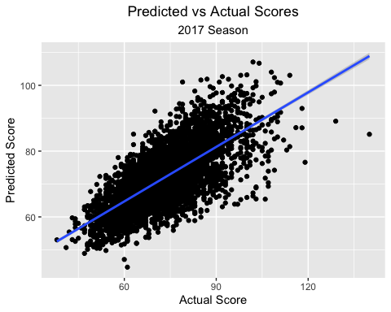
PREDICTION
Support Vector Machine
Mean of squared error is better at 60.83469.
The root mean squared error increased to 7.96 (worst of all three models).
For higher scores the predictions become more volatile.

Slide 9
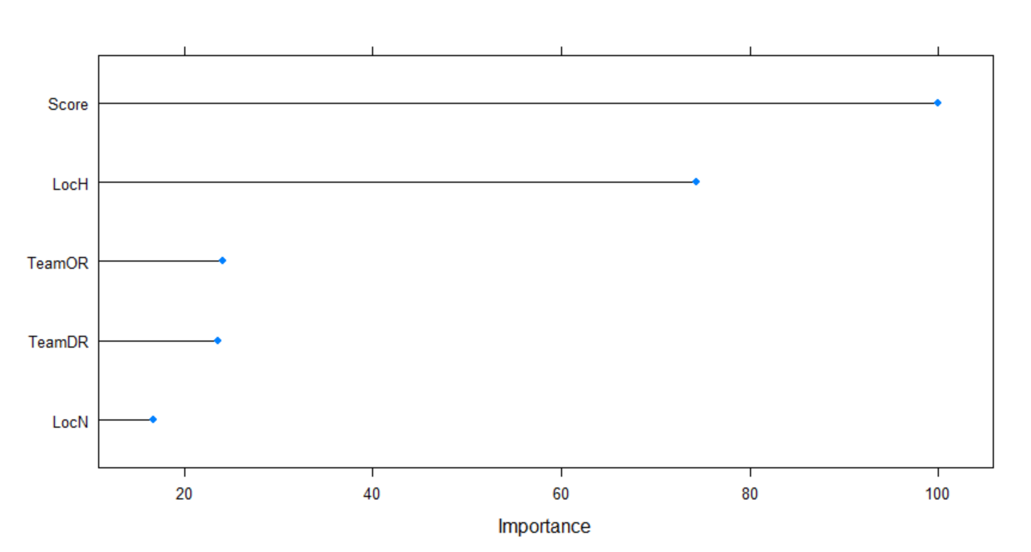
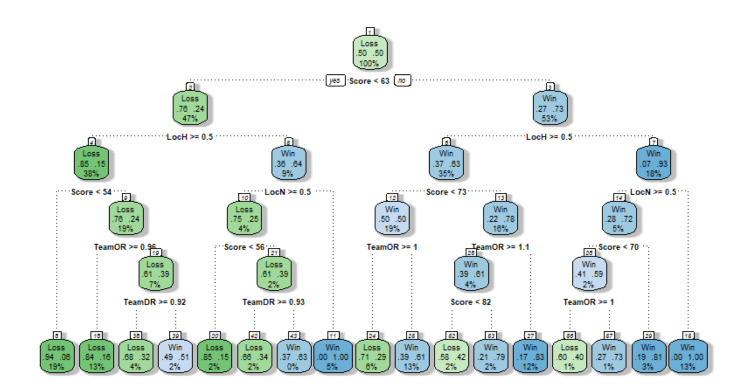
PREDICTION
Decision Tree 1
First model utilizes only 2008-2017 regular season games.
The model predicted 81% of the 2017 tournament games correctly.
Final Score, Home Games and the Offensive Rating of the teams were the three most important variables in determining the outcome of the game.

Slide 10
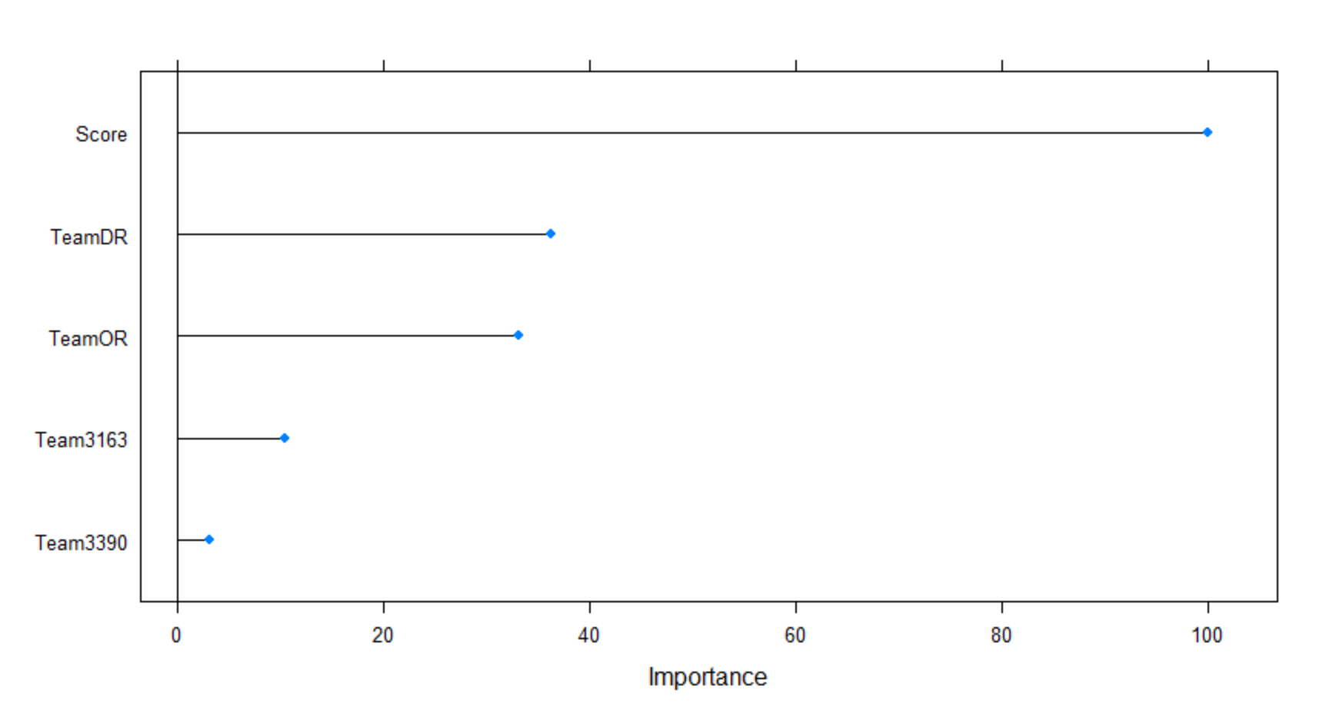
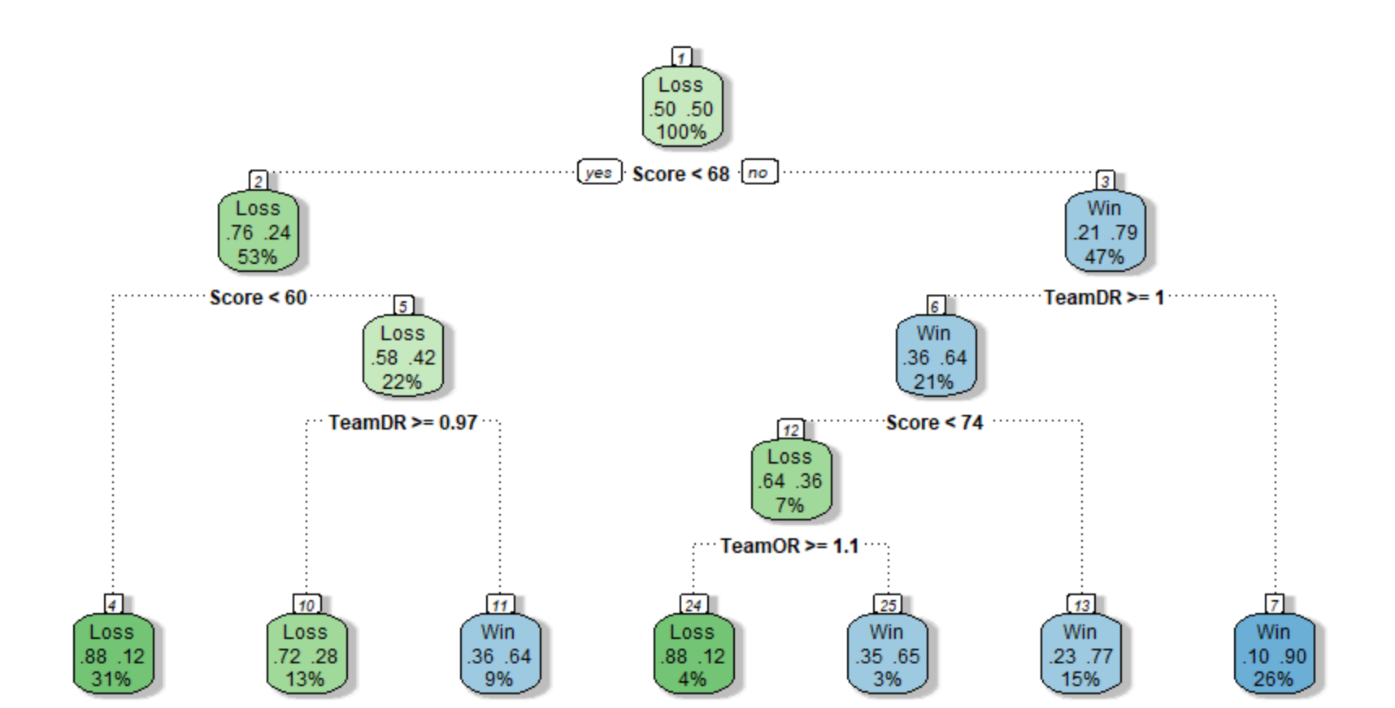
PREDICTION
Decision Tree 2
Second model utilizes only 2008-2016 tournament games.
The model predicted 81% of the 2017 tournament games correctly.
Final Score, Offensive Rating and the Defensive Rating of the teams were the three most important variables in determining the outcome of the game.
Home team advantage was not as important for tournament games as it was for regular season games.

Slide 11
CONCLUSION
Of the three models used for predicting the winning score, Random Forest seem to work best.
Random Forest has a RMSE value of 7.54.
SVM had a RMSE of 7.96.
Linear regression had a RMSE of 7.89.
Decision Tree model achieved 82% accuracy predicting the winning teams using only previous seasons tournament data to train the model.
Would be interesting to see the effect of other game statistic additions to the dataset.
Including statistics such as hooting percentage, fouls per game, number of triples and rebounds could improve the model
Would likely provide better representation on how a team both attacks and defends.
Including more data into the training of the model would likely increase the accuracy of our results.

Slide 12
Thank You!

